Slide 1
Stream API

Slide 2
Stream API
What is it?
Overall overview
Parallel/sequential
Primitive/boxed
Stream source
Infinite streams
Intermediate operations
Terminal operations
Limitations(no take while)

Slide 3
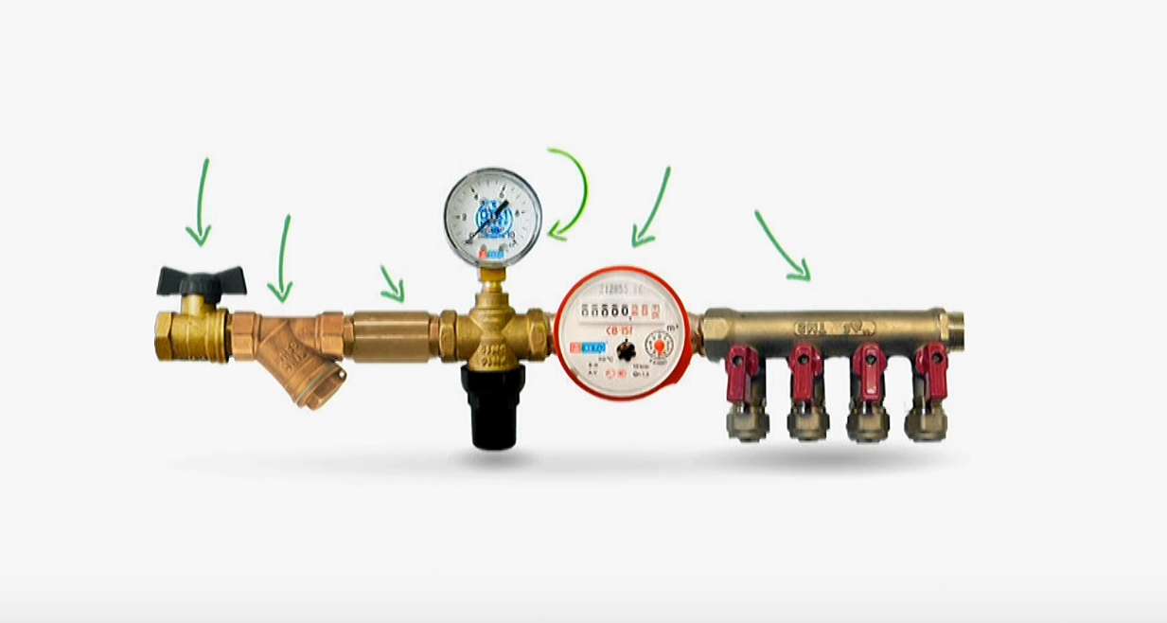
What is it?
pressure-reducing regulator
with gauge
Stabbing valve
Counter
Сoarse mesh filter
Collector
Back-flow valve

Slide 4
Sources
source.stream()

Slide 5
Intermediate operations
.map(block -> block.squash())

Slide 6
Intermediate operations
.filter(block -> block.getColor() != YELLOW)

Slide 7
Terminal operations
.forEach(block -> block.display());

Slide 8
Make pipeline
blocks.stream() .map(block -> block.squash()) .filter(block -> block.getColor() != YELLOW) .forEach(block -> block.display());

Slide 9
Add one more
.peek(counter::increment)

Slide 10
Rebuild the pipeline
blocks.stream() .map(block -> block.squash())
.peek(counter::increment) .filter(block -> block.getColor() != YELLOW) .forEach(block -> block.display());

Slide 11
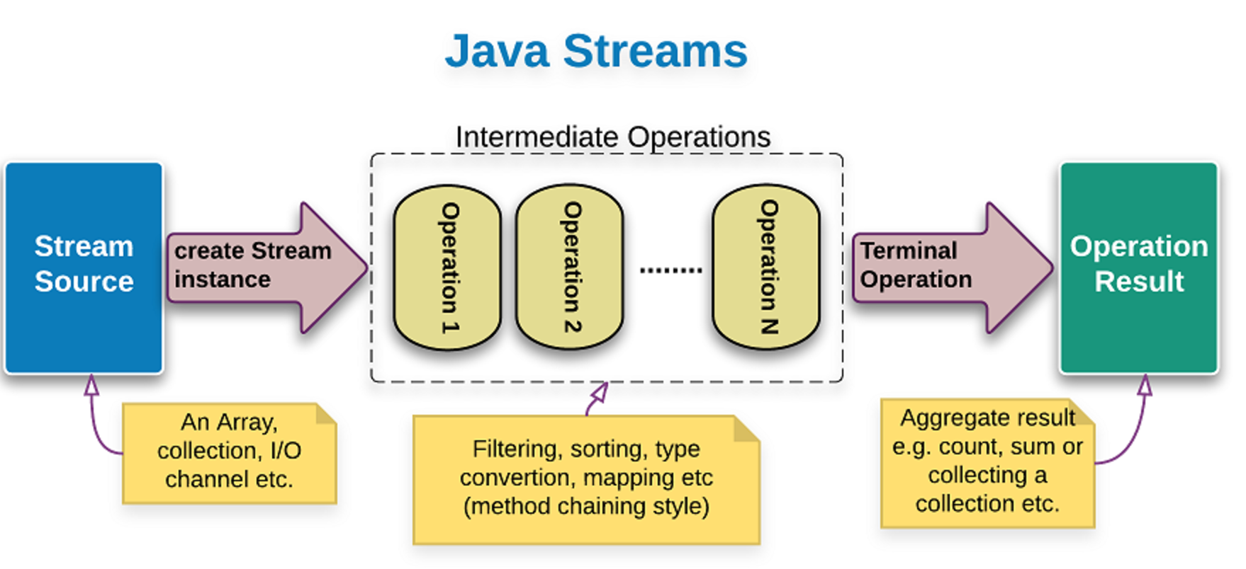
Overview
Source -> Intermediate operations(Optional) ->Terminal operations

Slide 12
Conclusion:
Simply put, streams are wrappers around a data source, allowing us to operate with that data source and making bulk processing convenient and fast.
A stream does not store data and, in that sense, is not a data structure. It also never modifies the underlying data source.
Streams can not be reused
Lazy calculations
Not real function style

Slide 13
Stream creation
From array:
Employee[] arrayOfEmps = { new Employee(1, "Jeff Bezos", 100000.0), new Employee(2, "Bill Gates", 200000.0), new Employee(3, "Mark Zuckerberg", 300000.0) }; Stream<Employee> stream = Stream.of(arrayOfEmps);
LongStream longStream = Arrays.stream(new long[]{1,2,3,4});
From collection:
List<Employee> empList = Arrays.asList(arrayOfEmps); Stream<Employee> stream = empList.stream();
From elements:
Stream.of("Jeff Bezos", "Bill Gates", "Mark Zuckerberg");
Using stream builder:
Stream.Builder<Employee> empStreamBuilder = Stream.builder(); empStreamBuilder.accept(arrayOfEmps[0]); empStreamBuilder.accept(arrayOfEmps[1]); empStreamBuilder.accept(arrayOfEmps[2]); Stream<Employee> empStream = empStreamBuilder.build();

Slide 14
Operations
Stream operations are divided into intermediate and terminal operations.
Intermediate operations such as filter() return a new stream on which further processing can be done. Terminal operations, such as forEach(), mark the stream as consumed, after which point it can no longer be used further.
A stream pipeline consists of a stream source, followed by zero or more intermediate operations, and a terminal operation.

Slide 15
filter
Intermediate operation test stream elements for a condition and generate filtered list.
List<Integer> myList = new ArrayList<>(); for(int i=0; i<100; i++) myList.add(i); Stream<Integer> sequentialStream = myList.stream(); Stream<Integer> highNums = sequentialStream.filter(p -> p > 90);
//filter numbers greater than 90 System.out.print("High Nums greater than 90="); highNums.forEach(p -> System.out.print(p+" ")); //prints "High Nums greater than 90=91 92 93 94 95 96 97 98 99 "

Slide 16
map
Intermediate operation map() produces a new stream after applying a function to each element of the original stream. The new stream could be of different type.
Stream<String> names = Stream.of("aBc", "d", "ef"); System.out.println(names.map(s -> { return s.toUpperCase(); }).collect(Collectors.toList())); //prints [ABC, D, EF]

Slide 17
sorted
Intermediate operation sorted() sorts the stream elements by passing Comparator argument.
Stream<String> names2 = Stream.of("aBc", "d", "ef", "123456"); List<String> reverseSorted = names2.sorted(Comparator.reverseOrder()).collect(Collectors.toList()); System.out.println(reverseSorted); // [ef, d, aBc, 123456] Stream<String> names3 = Stream.of("aBc", "d", "ef", "123456"); List<String> naturalSorted = names3.sorted().collect(Collectors.toList()); System.out.println(naturalSorted); //[123456, aBc, d, ef]

Slide 18
flatMap
Intermediate operation sorted() returns a stream consisting of the results of replacing each element of this stream with the contents of a mapped stream produced by applying the provided mapping function to each element. Each mapped stream is closed after its contents have been placed into this stream. (If a mapped stream is null an empty stream is used, instead.)
A developer knows a set of programming languages: public class Developer { private String name; private Set<String> languages; public Developer(String name) { this.languages = new HashSet<>(); this.name = name; } public void add(String language) { this.languages.add(language); } public Set<String> getLanguages() { return languages; } }

Slide 19
flatMap
A team has more than one developers. Now we would like to know the aggregate programming language skills for a given team. Stream#flatMap is perfect for "flattening" collections: public class FlatMapTest { @Test public void flatMap() { List<Developer> team = new ArrayList<>(); Developer polyglot = new Developer("esoteric"); polyglot.add("clojure"); polyglot.add("scala"); polyglot.add("groovy"); polyglot.add("go"); Developer busy = new Developer("pragmatic"); busy.add("java"); busy.add("javascript"); team.add(polyglot); team.add(busy); List<String> teamLanguages = team.stream(). map(d -> d.getLanguages()). flatMap(l -> l.stream()). collect(Collectors.toList()); assertTrue(teamLanguages.containsAll(polyglot.getLanguages())); assertTrue(teamLanguages.containsAll(busy.getLanguages())); } }

Slide 20
peek
Intermediate operation peek() is needed to perform multiple operations on each element of the stream before any terminal operation is applied.
peek() can be useful in situations like this. Simply put, it performs the specified operation on each element of the stream and returns a new stream which can be used further
Stream.of("bus", "car", "metro", "plane", "train") .filter(e -> e.length() > 3) .peek(e -> System.out.println("Filtered value: " + e)) .peek(Integer::valueOf) .peek(e -> System.out.println("Mapped value: " + e)) .collect(Collectors.toList());
Peek vs map:
use map to transform model to other model
use peek, to do something that consumes this object, but does not modify it (send a notification, print model, etc)

Slide 21
forEach
forEach() is simplest and most common operation; it loops over the stream elements, calling the supplied function on each element.
empList.stream().forEach(e -> e.salaryIncrement(10.0));
forEach() is a terminal operation, which means that, after the operation is performed, the stream pipeline is considered consumed, and can no longer be used.

Slide 22
reduce
reduce() is used to perform a reduction on the elements of the stream, using an associative accumulation function, and return an Optional. Let’s see how we can use it multiply the integers in a stream.
Stream<Integer> numbers = Stream.of(1, 2, 3, 4, 5); Optional<Integer> intOptional = numbers.reduce((i, j) -> { return i * j; }); if (intOptional.isPresent()) { System.out.println("Multiplication = " + intOptional.get()); //120 }
reduce() is a terminal operation, which means that, after the operation is performed, the stream pipeline is considered consumed, and can no longer be used.

Slide 23
count
count() is used to count the number of items in the stream.
Stream<Integer> numbers1 = Stream.of(1,2,3,4,5); System.out.println("Number of elements in stream="+numbers1.count()); //5
In JAVA 8 count() is eager.
count() is a terminal operation, which means that, after the operation is performed, the stream pipeline is considered consumed, and can no longer be used.

Slide 24
match
macth() is used to check whether there are elements that match or do not match to a predicate.
Stream<Integer> numbers3 = Stream.of(1,2,3,4,5); System.out.println("Stream contains 4? "+numbers3.anyMatch(i -> i==4)); //Stream contains 4? true Stream<Integer> numbers4 = Stream.of(1,2,3,4,5); System.out.println("Stream contains all elements less than 10? "+numbers4.allMatch(i -> i<10)); //Stream contains all elements less than 10? true Stream<Integer> numbers5 = Stream.of(1,2,3,4,5); System.out.println("Stream doesn't contain 10? "+numbers5.noneMatch(i -> i==10)); //Stream doesn't contain 10? True
match() is a terminal operation, which means that, after the operation is performed, the stream pipeline is considered consumed, and can no longer be used.

Slide 25
findFirst
findFirts() is used to get first element from the stream.
Stream<String> names4 = Stream.of("Pankaj","Amit","David", "Lisa");
Optional<String> firstNameWithD = names4.filter(i -> i.startsWith("D")).findFirst();
if(firstNameWithD.isPresent()){ System.out.println("First Name starting with D="+firstNameWithD.get()); //David }
findFirst() is a terminal operation, which means that, after the operation is performed, the stream pipeline is considered consumed, and can no longer be used.

Slide 26
collect
collect() is used to get a Collection or Array from a java Stream.
Stream<Integer> intStream = Stream.of(1,2,3,4); List<Integer> intList = intStream.collect(Collectors.toList()); System.out.println(intList); //prints [1, 2, 3, 4] Map<Integer,Integer> intMap = Stream.of(1,2,3,4).collect(Collectors.toMap(i -> i, i -> i+10)); System.out.println(intMap); //prints {1=11, 2=12, 3=13, 4=14}
Map<BlogPostType, List<BlogPost>> postsPerType = posts.stream() .collect(groupingBy(BlogPost::getType));
Stream.of("a", "b", "c").collect(Collectors.joining("_"));
collect() is a terminal operation, which means that, after the operation is performed, the stream pipeline is considered consumed, and can no longer be used.

Slide 27
Infinite streams
Iterate:
IntStream.iterate(2, n -> n*n) .limit(5) .forEach(System.out::println);
It is possible to have internal state with iterate
Nth Fibonacci number:
Stream.iterate(new long[]{1, 1}, p -> new long[]{p[1], p[0] + p[1]}) .limit(91).skip(90).findFirst().get()[1];
Generate:
It is not possible to have internal state with iterate
Stream.generate(Math::random) .limit(5) .forEach(System.out::println);

Slide 28
Limitations
takeWhile() is available only from JAVA 9, so there is no way to use break in streams.
Some operations are eager, so they will go through all elements.

Slide 29
Stream API best practices
Do NOT use it if you do not understand how it works.
Avoid side effects
Stream is a tool. Sometimes it is good but sometimes bad. Use it wisely and prefer loops where they are better. Do NOT use streams if it looks worse than loops.
//BAD:
Stream<Pair> allFactorials = Stream.iterate( new Pair(BigInteger.ONE, BigInteger.ONE), x -> new Pair( x.num.add(BigInteger.ONE), x.value.multiply(x.num.add(BigInteger.ONE)))); return allFactorials.filter( (x) -> x.num.equals(num)).findAny().get().value;
//GOOD:
BigInteger acc = BigInteger.ONE; for(long i = 2; i <=x; i++) { acc = acc.multiply(BigInteger.valueOf(i)); } return acc;
Functional 1000 100 avgt 20 9748276,035 ± 222981,283 ns/op
Traditional 1000 100 avgt 20 6360620,309 ± 135236,735 ns/op

Slide 30
Stream API best practices
One stream method call per line. This will make stream operations like map, filter and collect easily recognizable.
// BAD CODE: strings.stream().filter(s -> s.length() > 2).sorted() .map(s -> s.substring(0, 2)).collect(Collectors.toList()); // GOOD CODE: strings.stream() .filter(s -> s.length() > 2) .sorted() .map(s -> s.substring(0, 2)) .collect(Collectors.toList());

Slide 31
Stream API best practices
Prefer method references to lambdas
// AVOID: strings.stream() .map(s -> s.length()) .collect(toList()); // PREFER: strings.stream() .map(String::length) .collect(toList());

Slide 32
Stream API best practices
Use IntStream, LongStream and DoubleStream when working with primitive types. They are faster (they avoid boxing) and easier to use (they add useful methods like sum).
Stream<String> strings = Stream.of("a", "foo", "bar", "baz"); double averageLength = strings .mapToInt(String::length) .summaryStatistics() .getAverage();
Use mapTo[Int|Long|Double] and mapToObj to convert between a stream and a specialized primitive stream.

Slide 33
Stream API best practices
learn about static helper methods exposed by specialized stream classes:
// prints: 0 1 2 3 4 5 6 7 8 9 IntStream.range(0, 10) .forEach(System.out::println); // prints: 1 2 4 8 16 32 64 128 256 512 IntStream.iterate(1, i -> 2*i) .limit(10) .forEach(System.out::println); // prints: -376368599 2112239618 // just to demo generate method: IntStream.generate(random::nextInt) .limit(2) .forEach(System.out::println); // prints: -1134353240 2007034835 // stream of random int's - more idiomatic way: random.ints() .limit(2) .forEach(System.out::println);

